Slide 1

BFX-UA300 Verify
LED light abnormal
Prepared by: PE- Long
Date : 2023.08.25
"Listens to customers, Meet customer expectation"

Slide 2
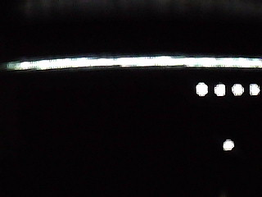
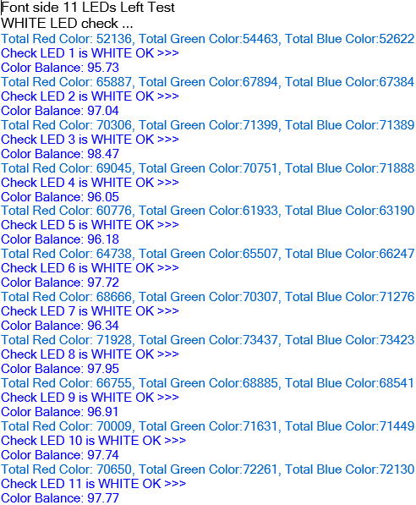
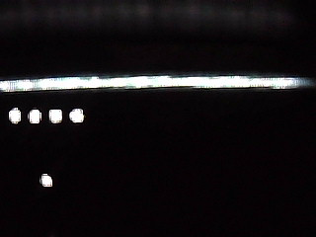
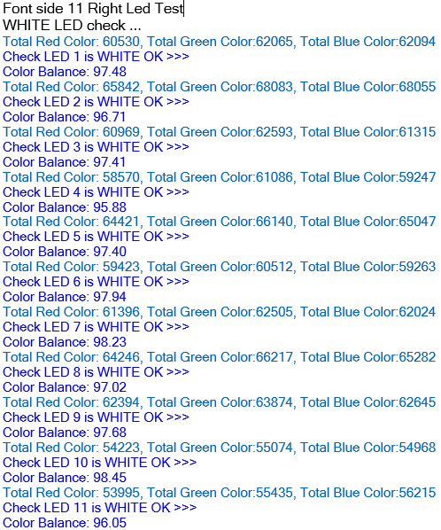
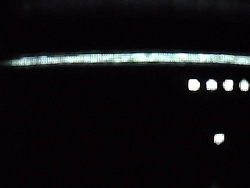
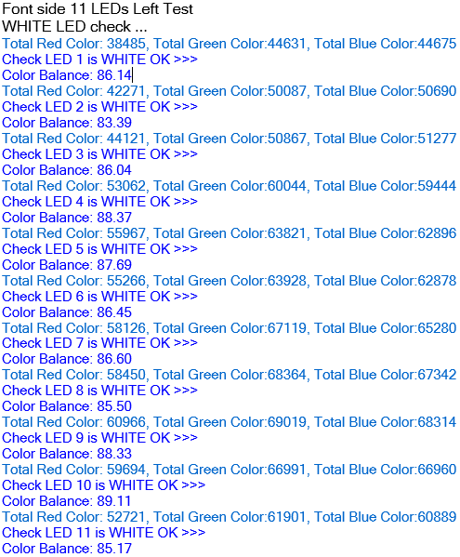
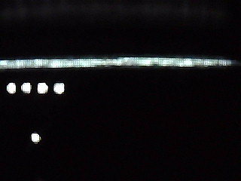
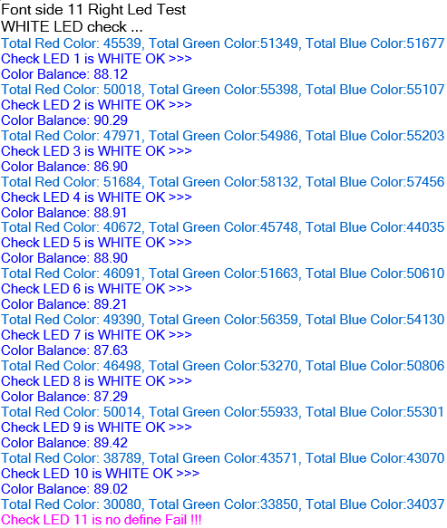
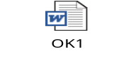

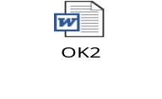
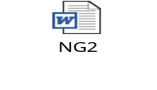
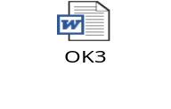
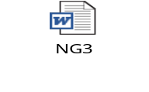
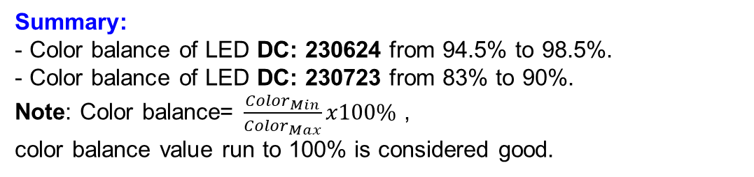
LED Sample Verify
LEDs Left
LEDs Right
DC: 230624
DC: 230723
Summary:
- Color balance of LED DC: 230624 from 94.5% to 98.5%.
- Color balance of LED DC: 230723 from 83% to 90%.
Note: Color balance= $\frac{{Color}_{Min}}{{Color}_{Max}}x100\%$ ,
color balance value run to 100% is considered good.
Times | DC:230624 | DC:230723
1
2
3
Log verify
"Listens to customers, Meet customer expectation"

Slide 3
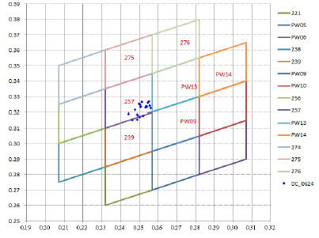
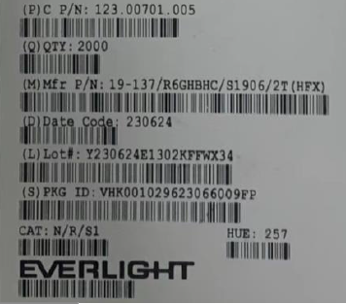
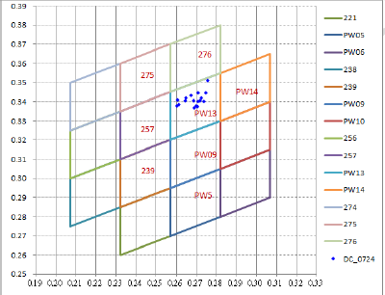
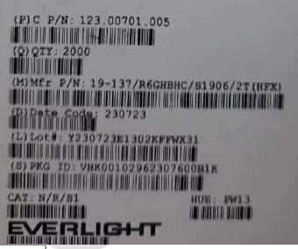
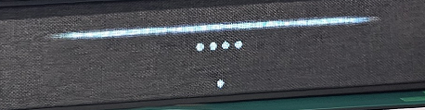
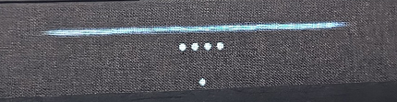
LED Sample Datecode: 230624 & 230723
All prior of DC 230624
Since DC 230722 onwards
DC 230624 Bin code is 257
DC 230723 Bin code is PW13
Everlight confirmed have total 16 Bins code in range, and the color each DC different a litter cause by different Bin code. But all they are still in spec. So with Fii production is no issue. All functions test can cover LED no light and light abnormal. From LED DC 230722 onward we need new define color balance spec. Suggestion color balance from 80%
"Listens to customers, Meet customer expectation"

